Slide 1

Project 1 Stock-Market Analysis
Sonu Sharma Mete Ozkazanc
Brandon Allen Ryan Goda

Slide 2
Introduction Summary:
What type of data are we looking at and what is the timeframe of our data?
In this project, we will be looking at a 5-year portion of NASDAQ stock data ranging from 2019 – 2024.
Where did we acquire our data?
We acquired our CSV data set from ”Go-Charting” and acquired our outlier events from “Morningstar”, “Google Finance”, “New York Times”, and “MarketWatch”.
In the data, what could be incorrect?
From our dataset, we believe no information to be incorrect. We do note that of all the available days; Monday – Friday, 9:30AM – 4:00PM the stock market could be open, it is not due to certain holidays. Therefore, any forecasting methods used may show a slightly misconstrued utilization rate.
We must also ask if our dataset includes data outside of regular trading hours; which it does not.
What Analysis / Plots / Time-Series information will we be running on our data?
In this project, we utilized concatenation, forecasting, model-prediction, data cleaning, maximums, minimum, averages, correlations, to-datetime, and indexing.
Explain our columns and their meanings.
Open: Opening Price of the Market. Close: Closing price of the Market. High: Highest price reached in that single time-period. Low: Lowest price reached in that single time-period. Adjusted Close: Closing price after the lag of the market has caught up, Volume: The Volume of Currency that moved through the NASDAQ in that single time-period. Headline: News articles corresponding to a specific date of a specific time-period filter-searching the words “United States Economy”.

Slide 3
How we analyzed our conceptual data questions:
Conceptual Data:
Points regarding news of speculation vs. authentic news:
When dealing with markets, it should be noted that not all news sources are accurate in their research, and many speculate news.
While this isn’t uncommon, it can lead investors to believe they are gaining access to authentic news, leading them to make a play within the market on possible fabricated information.
Were there any expected outliers in the data?
From our dataset and due to this information being historical, we expect to see outlier data during or near the time-periods of major foreign and domestic events. A few of these events include COVID-19, Global Conflicts, and Interest Rate fluctuations.
What news outlets did we utilize to identify information that could result in outlier data?
As previously mentioned, we created a column named “Headline” to help us and the audience identify potential reason for outlier data indications through utilizing a New York Times API Key to filter-search articles for each day pertaining to the filter “United States Economy.”

Slide 4
Our Data #1:
From our Data:
Explain our main variables.
Explain how we sliced the data.
This entails our breakdown of the 5-year data set as-is and forecasted. This can be:
One 2019 as-is dataset. One 2019 forecasted dataset.
One 2020 – 2022 as-is dataset. One 2020 – 2022 forecasted dataset.
One 2022 – 2024 as-is dataset. One 2022 – 2024 forecasted dataset.
We can adjust these dates as we see fit, we may or may not need less or more dataset slices.

Slide 5
Our Data #2:

Slide 6
Plots & Analysis:
Should be around 6 plots here with concise explanations and proper labelling.

Slide 8
Goals & Solutions:
From our data we can see that outlier events directly correlated with unusual fluctuations in the stock market. Through our 2019 stock market information, we were able to see what a regular market looks like, in comparison to our other datasets from different years.
Wrap:
In solution to our analysis, it is important to remember that the stock market moves in a relatively random manner. Value increases and decreases through global events, some of which are out of our control.
In preparation for scenarios such as outlier events, we believe it would be best to begin by taking precautionary steps in the event something happens and placing “stops” on your investments.
Along with this, we encourage one to consider the authenticity of their news source. Phony information can be a detriment to oneself and a long-awaited entry point to someone else.
The ability to forecast future data is available to everyone. We recommend looking for yourself and doing your own research.
Finally, understanding volatility of the stock market is a skill worth having. Investing in a highly volatile market may lead to increased losses yet also increased gains in comparison to a stable market. This can be explained through the ”Security Market Line.”

Slide 9
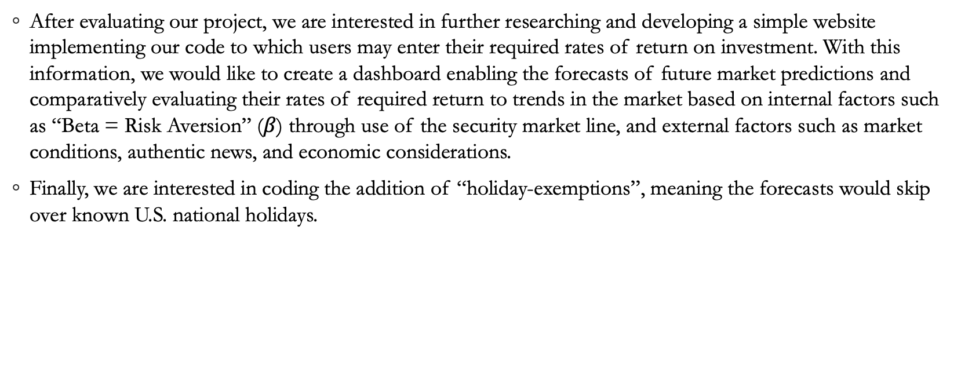
Post-Evaluation:
After evaluating our project, we are interested in further researching and developing a simple website implementing our code to which users may enter their required rates of return on investment. With this information, we would like to create a dashboard enabling the forecasts of future market predictions and comparatively evaluating their rates of required return to trends in the market based on internal factors such as “Beta = Risk Aversion” ($β$) through use of the security market line, and external factors such as market conditions, authentic news, and economic considerations.
Finally, we are interested in coding the addition of “holiday-exemptions”, meaning the forecasts would skip over known U.S. national holidays.

